Slide 1
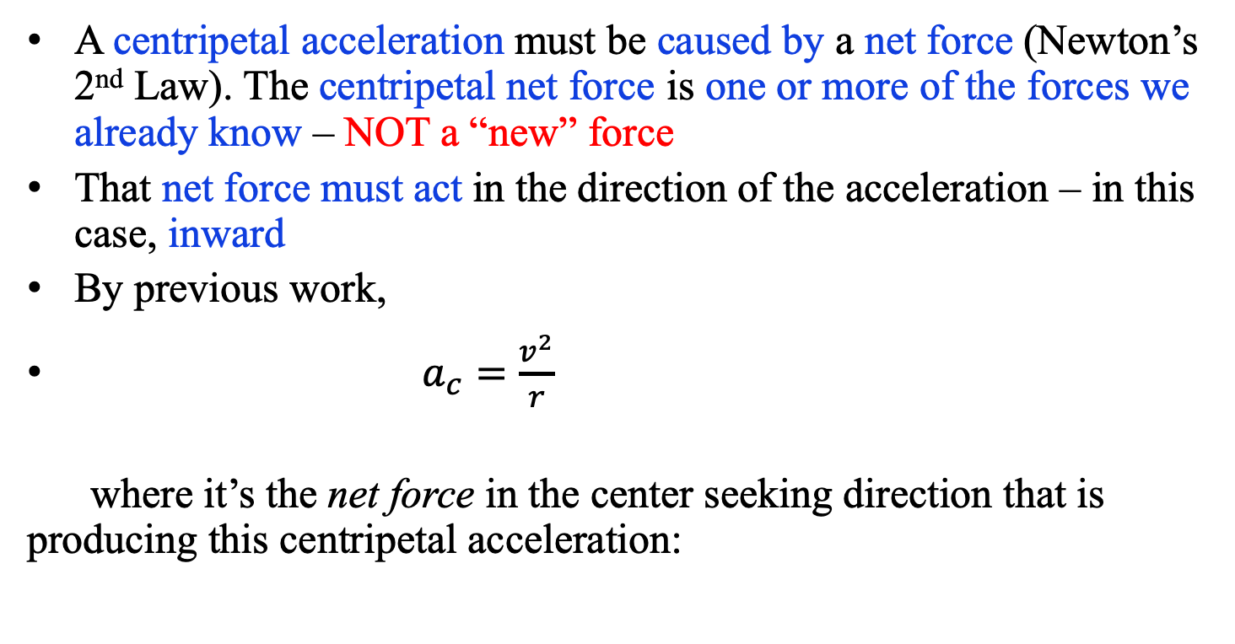
Reminders about centripetal motion
A centripetal acceleration must be caused by a net force (Newton’s 2nd Law). The centripetal net force is one or more of the forces we already know – NOT a “new” force
That net force must act in the direction of the acceleration – in this case, inward
By previous work,
$a_{c}=\frac{v^{2}}{r}$
where it’s the net force in the center seeking direction that is producing this centripetal acceleration:

Slide 2
How to tackle a centripetal motion problem:
Draw an FBD and label, as usual.
Find the center of the circle in which the object is moving, and make that direction one of your coordinate axes. Make the other axis perpendicular to it (along the tangential direction).
  Often, you’ll also need the normal direction to the plane of motion, too – you’ll see why when we work problems.
Find the net force in the centripetal direction, 𝝨F_{c}.
  Forces pointing towards the center of the circle are positive
  Forces pointing away from the center are negative
Use N2L to solve in each direction (centripetal, tangential, normal) as needed.

Slide 3

Centripetal Direction Review:
1.) A snapshot is taken of a body circling as shown. Draw a f.b.d. for the forces on the body as shown, including the appropriate coordinate axes.
L
m
2.) A snapshot is taken of a body swinging back and forth as shown. Draw a f.b.d. for the forces on the body as shown, including the appropriate coordinate axes.
L
m
THE KEY: FIND THE CENTER OF THE ARC UPON WHICH THE BODY IS MOVING. THE CENTRIPETAL DIRECTION WILL BE FROM THE BODY TO THAT CENTER!!!

Slide 4
Problem 7.21
A 55.0-kg ice skater is moving at 4.00 m/s when she grabs the loose end of a rope, the opposite end of which is tied to a pole. She then moves in a circle of radius 0.800 m around the pole.
(a) Determine the force exerted by the horizontal rope on her arms.
(b) Compare this force with her weight.
It’s about twice her weight.

Slide 5
What is the maximum velocity the car could pass over the top of the hill without lifting off? Note that the car’s wheels are ROLLING over the hill, which means friction is negligible.
What happens to the normal force if the car just skims through the top of the arc? It goes to zero. So you would do this problem
exactly as you did it in the previous section, except at the end you would let N go to zero and you’d solve for v. That is:
Observation: Notice how important it is to get that negative sign in front of the acceleration term? If it wasn’t there, you’d be trying to take the square root of a negative number, which is never a good thing.
21.)

Slide 6
Pendulum
A pendulum swings back and forth – let’s assume ideal motion, so it swings to equal heights each time without losing energy.
  Draw an FBD for the pendulum bob at the bottom of the arc.
  Determine an expression for the acceleration of the bob at the bottom of its motion.
  Draw an FBD of the bob about halfway up its arc.
  Determine an expression for the acceleration of the bob at this point.

Slide 7
Non-uniform Circular Motion:
Consider a mass m attached to a string of length L that is suspended from the ceiling. At some point, it makes an angle with the vertical moving upward with velocity .
a.) Derive an expression for the tension in the string.
f.b.d.
What’s tricky is the axes . . .
49.)

Slide 8
Breaking forces into components:
f.b.d.
b.) Derive an expression for the magnitude of the translational acceleration of the mass.
50.)

Slide 9
Pendulum
On a sketch of the pendulum, for each position shown, draw and label an arrow for the:
  Velocity vector of the bob at that point (center, and halfway up)
  Net acceleration (and therefore net force) of the pendulum at that point
Max h
F_{T}
F_{T}
a_{net}
F_{T}
a_{net}
v
v
F_{G}
a_{net}
F_{G}
F_{G}
v

Slide 10
Car on a flat curve
What is the maximum velocity a car can take a flat curve of radius “R” if the coefficients of friction are and respectively?
R
v

Slide 11
Friction and Wheels
Looking down through a car, what happens when you crank the wheel to make a hard right turn?
25.)

Slide 12
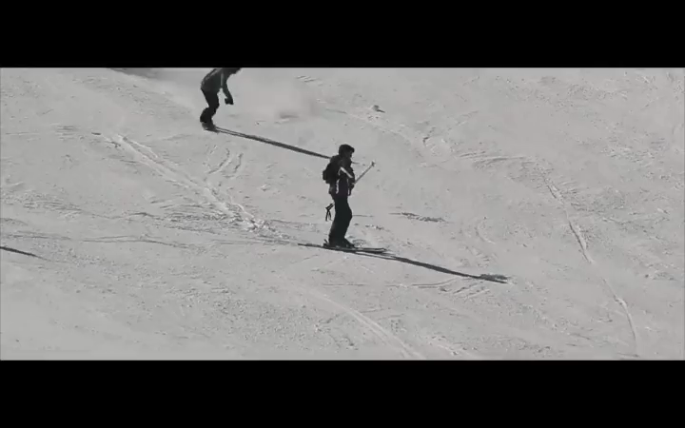
A turning car wheel does to a street what a turning skier does to snow . . .
1.)

Slide 13
In other words, the tires apply a static frictional force to the road outward (this is like the skis pushing outward on the snow, spraying it outward on unsuspecting shooshers)
27.)

Slide 14
In other words, the tires apply a static frictional force to the road outward (this is like the skis pushing outward on the snow, spraying it outward on unsuspecting revelers) as the road pushes INWARD on the tires.
The direction of the force on the tires by the road is perpendicular to the tires (as shown).
28.)

Slide 15
Examining the forces in the exaggerated presentation on one tire:
If the angle is big (i.e., with the wheels turned a lot), the radius of the arc is small and the static frictional force has two components:
--one component is along the line-of-motion. It tends to slow the motion of the car.
--one component is perpendicular to the line-of-motion. It pushes the car out of straight-line motion.
29.)

Slide 16
If the angle is small (i.e., with the wheels turned just a bit), the radius of the arc is huge and the static frictional force is almost entirely directed in the center seeking (centripetal) direction.
In that case, we assume that ALL of the static frictional force is centripetal.
That is the standard assumption made in these problems.
30.)

Slide 17
Car on a flat curve - solution
Start with a free body diagram as viewed from the front of the car:
As viewed head-on:
As the static frictional force is in the center seeking direction, N.S.L. becomes:
Follow up question: if the radius of the curve doubles, by how much does the critical velocity change?
V is 1.41 times bigger – v is proportional to $\sqrt{2}$. Doubling radius does NOT double velocity.

Slide 18
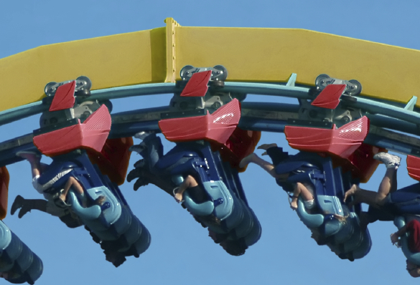
Consider a 100 kg rollercoaster car traveling inverted through the top of a vertically oriented circular loop of radius 20 meters.
a.) At what speed should the car travel through the top of the loop if the track is not to supply any force on the car?
f.b.d.
46.)

Slide 19
b.) Describe the force supplied by the track if the car travels 5 m/s faster than the free fall speed calculated in Part a.
The track will have to provide a normal force to appropriately push the car out of its straight line motion. Soooo . . .
f.b.d.
47.)

Slide 20
c.) Describe the force supplied by the track if the car travels 5 m/s slower than the free fall speed calculated in Part a.
The track will again have to provide a normal force in the centripetal direction, this time to keep the car from falling. Soooo . . .
f.b.d.
48.)

Slide 21
Rollercoaster loop!
A roller coaster includes a loop that has a radius of 12 m. What is the minimum speed the roller coaster cars have to have in order for passengers not to fall out of their seats at the top of the loop if they did not wear seatbelts?
  Hint: at the instant they just begin to fall out of their seats, what happens to one of the forces?

Slide 22
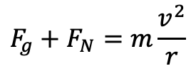
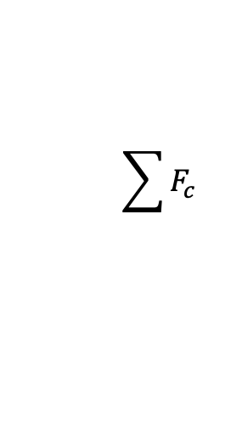
Rollercoaster loop
At the top of the loop, both gravity and the normal force by the track are pointing downward (towards the center of the loop):
Taking downward to be the + centripetal direction, from N2L:
F_{g}
F_{N}
$$\sum{F_{c}}$$
$$F_{g}+F_{N}=m\frac{v^{2}}{r}$$
At the minimum speed to go around the loop, the car will just be touching the track – so the normal force applied by the track will approach 0. Then:
$$mg=m\frac{v^{2}}{r}$$
$$⇒v= \sqrt{rg}$$
The “critical velocity” depends solely on the radius of the loop (and the planet…)

Slide 23
Rollercoaster loop
Follow-up questions:
  If F_{N} goes to zero at the top of the loop, what happens to the passengers’ sensation of their weight?
  What would a free body diagram look like at the bottom of the loop? How would you sum those forces?
  What would the passengers’ sensation of weight be like at the bottom?
Feel “weightless” – we sense weight because of F_{N} pushing back on us. If F_{N} goes to 0, we don’t “feel” our weight. (This is what is actually going on in space! Astronauts in orbit aren’t pushing against a floor, so they feel weightless – but g gravity IS acting on them because without it they wouldn’t orbit)
Now, F_{N} is providing the center-seeking force, and gravity is opposing it. So $\sum{F_{c}=F_{N}−F_{g}}$
F_{N}
F_{g}
Standing on level ground, motionless, F_{N} = F_{g} so we feel our full weight. At the bottom of the loop, F_{N} = F_{g} + ma, so passengers feel heavier than normal.

Slide 24
Rollercoaster loop
Finally, realistically, what happens to the velocity of the car as it travels up the loop to the top, and why? What’s the problem here?
It slows as it goes up – which means this isn’t actually uniform circular motion.
NOTE: Most loops are not circular but in fact a shape called a Clothoid Loop!
www.physicsclassroom.com

Slide 25
Dips and hills and loops (oh my…)
What happens if you go too fast over the top of a hill? Why?

Slide 26
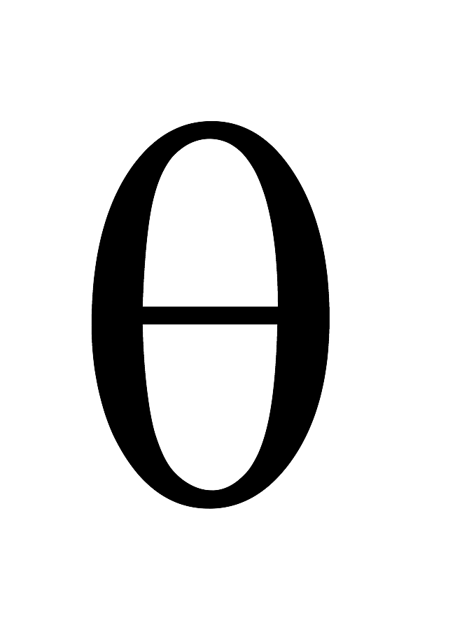
Banked curve – no friction
At what velocity must a car have to take a banked curve of radius R and angle theta if the bank’s surface is FRICTIONLESS?
R
As viewed from head-on
v

